Slide 1
Lecture #11: Counting and Probability 2
Combinations r-Combinations with Repetition Pascal’s Formula and the Binomial Theorem
Aaron Tan
AY2022/23 Semester 1

Slide 2
Combinations r-Combinations with Repetition Pascal’s Formula and the Binomial Theorem
11. Counting and Probability 2
This lecture is based on Epp’s book chapter 9.
Hence, the section numbering is according to the book.
9.5 Counting Subsets of a Set: Combinations
r-combination, r-permutation, permutations of a set with repeat elements, partitions of a set into r subsets
9.6 r-Combinations with Repetition Allowed
Multiset
9.7 Pascal’s Formula and the Binomial Theorem
9.8 Probability Axioms and Expected Value
Probability axioms, complement of an event, general union of two events, expected value
9.9 Conditional Probability, Bayes’ Formula, and Independent Events
Formula to use depends on whether (1) order matters, (2) repetition is allowed
Reference: Epp’s Chapter 9 Counting and Probability

Slide 3
Combinations r-Combinations with Repetition Pascal’s Formula and the Binomial Theorem
9.5 Counting Subsets of a Set: Combinations

Slide 4
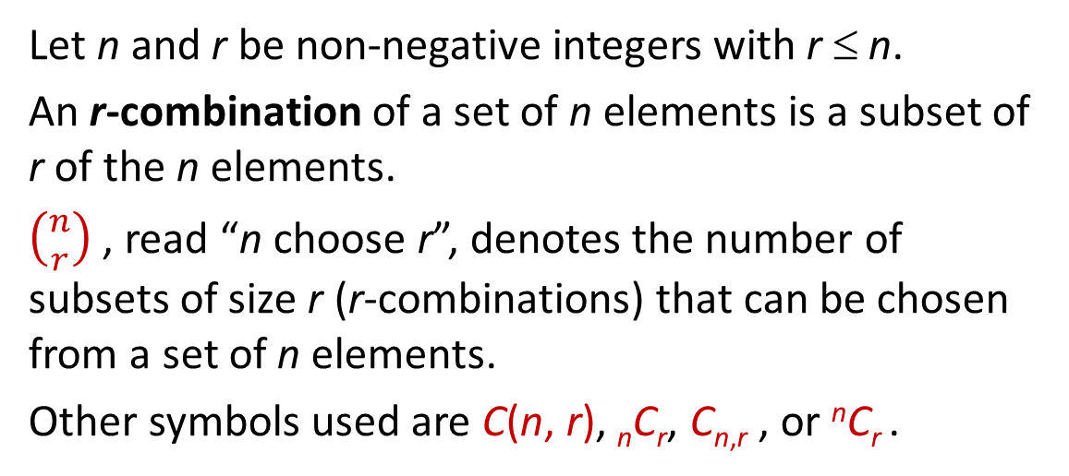
Combinations r-Combinations with Repetition Pascal’s Formula and the Binomial Theorem
Counting Subsets of a Set: Combinations
Counting Subsets of a Set: Combinations
Given a set S with n elements, how many subsets of size r can be chosen from S?
Each subset of size r is called an r-combination of the set.
Definition: r-combination
Let n and r be non-negative integers with r ≤ n.
An r-combination of a set of n elements is a subset of r of the n elements.
$\left({n \atop r}\right)$ , read “n choose r”, denotes the number of subsets of size r (r-combinations) that can be chosen from a set of n elements.
Other symbols used are C(n, r), _{n}C_{r}, C_{n,r} , or ^{n}C_{r} .

Slide 5

Combinations r-Combinations with Repetition Pascal’s Formula and the Binomial Theorem
Counting Subsets of a Set: Combinations
Example 1 – 3-Combinations
Let S = {Ann, Bob, Cyd, Dan}. Each committee consisting of three of the four people in S is a 3-combination of S.
List all such 3-combinations of S.
What is $\left({4 \atop 3}\right)$ ?
The 3-combinations are:
{Bob, Cyd, Dan}, {Ann, Cyd, Dan},
{Ann, Bob, Dan}, {Ann, Bob, Cyd}
$\left({4 \atop 3}\right)$ = 4

Slide 6
Combinations r-Combinations with Repetition Pascal’s Formula and the Binomial Theorem
Counting Subsets of a Set: Combinations
Example 2 – Ordered and Unordered Selection
Two distinct methods that can be used to select r objects from a set of n elements:
Ordered selection
Unordered selection
Also called r-permutation
Also called r-combination
Example: S = { 1, 2, 3 }
2-permutations of S
2-combinations of S
(1, 2)
(2, 1)
{1, 2}
(1, 3)
(3, 1)
{1, 3}
(2, 3)
(3, 2)
{2, 3}

Slide 7
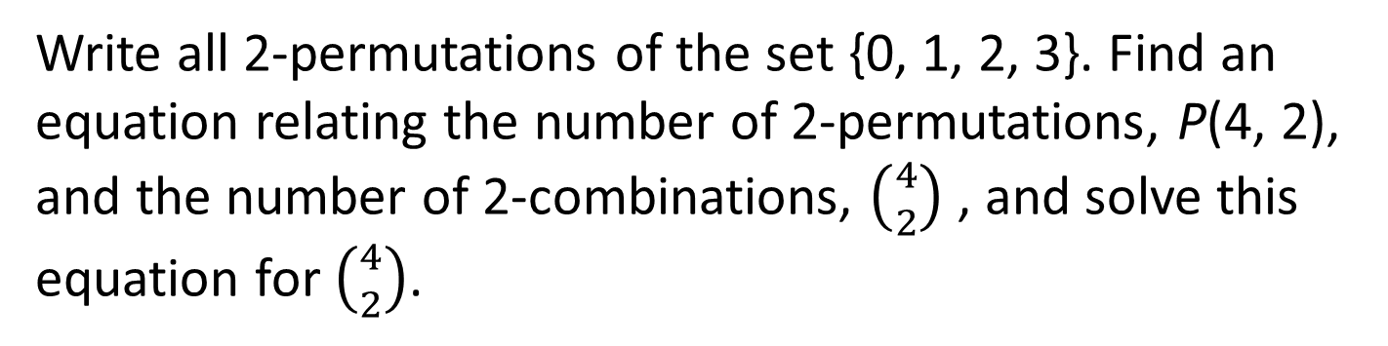
Combinations r-Combinations with Repetition Pascal’s Formula and the Binomial Theorem
Relationship between Permutations and Combinations
Example 3 – Relationship between Permutations and Combinations
Write all 2-permutations of the set {0, 1, 2, 3}. Find an equation relating the number of 2-permutations, P(4, 2), and the number of 2-combinations, $\left({4 \atop 2}\right)$ , and solve this equation for $\left({4 \atop 2}\right)$.
(0, 1),
(0, 2),
(0, 3),
(1, 2),
(1, 3).
(2, 3),
(1, 0),
(2, 0),
(3, 0),
(2, 1),
(3, 1).
(3, 2)
According to Theorem 9.2.3,
P(4, 2) = 4!/(4-2)! = 4!/2! = 12
The construction of a 2-permutation of {0, 1, 2, 3} can be thought of comprising two steps:
Step 1: Choose a subset of 2 elements from {0, 1, 2, 3}.
Step 2: Choose an ordering for the 2-element subset.

Slide 8
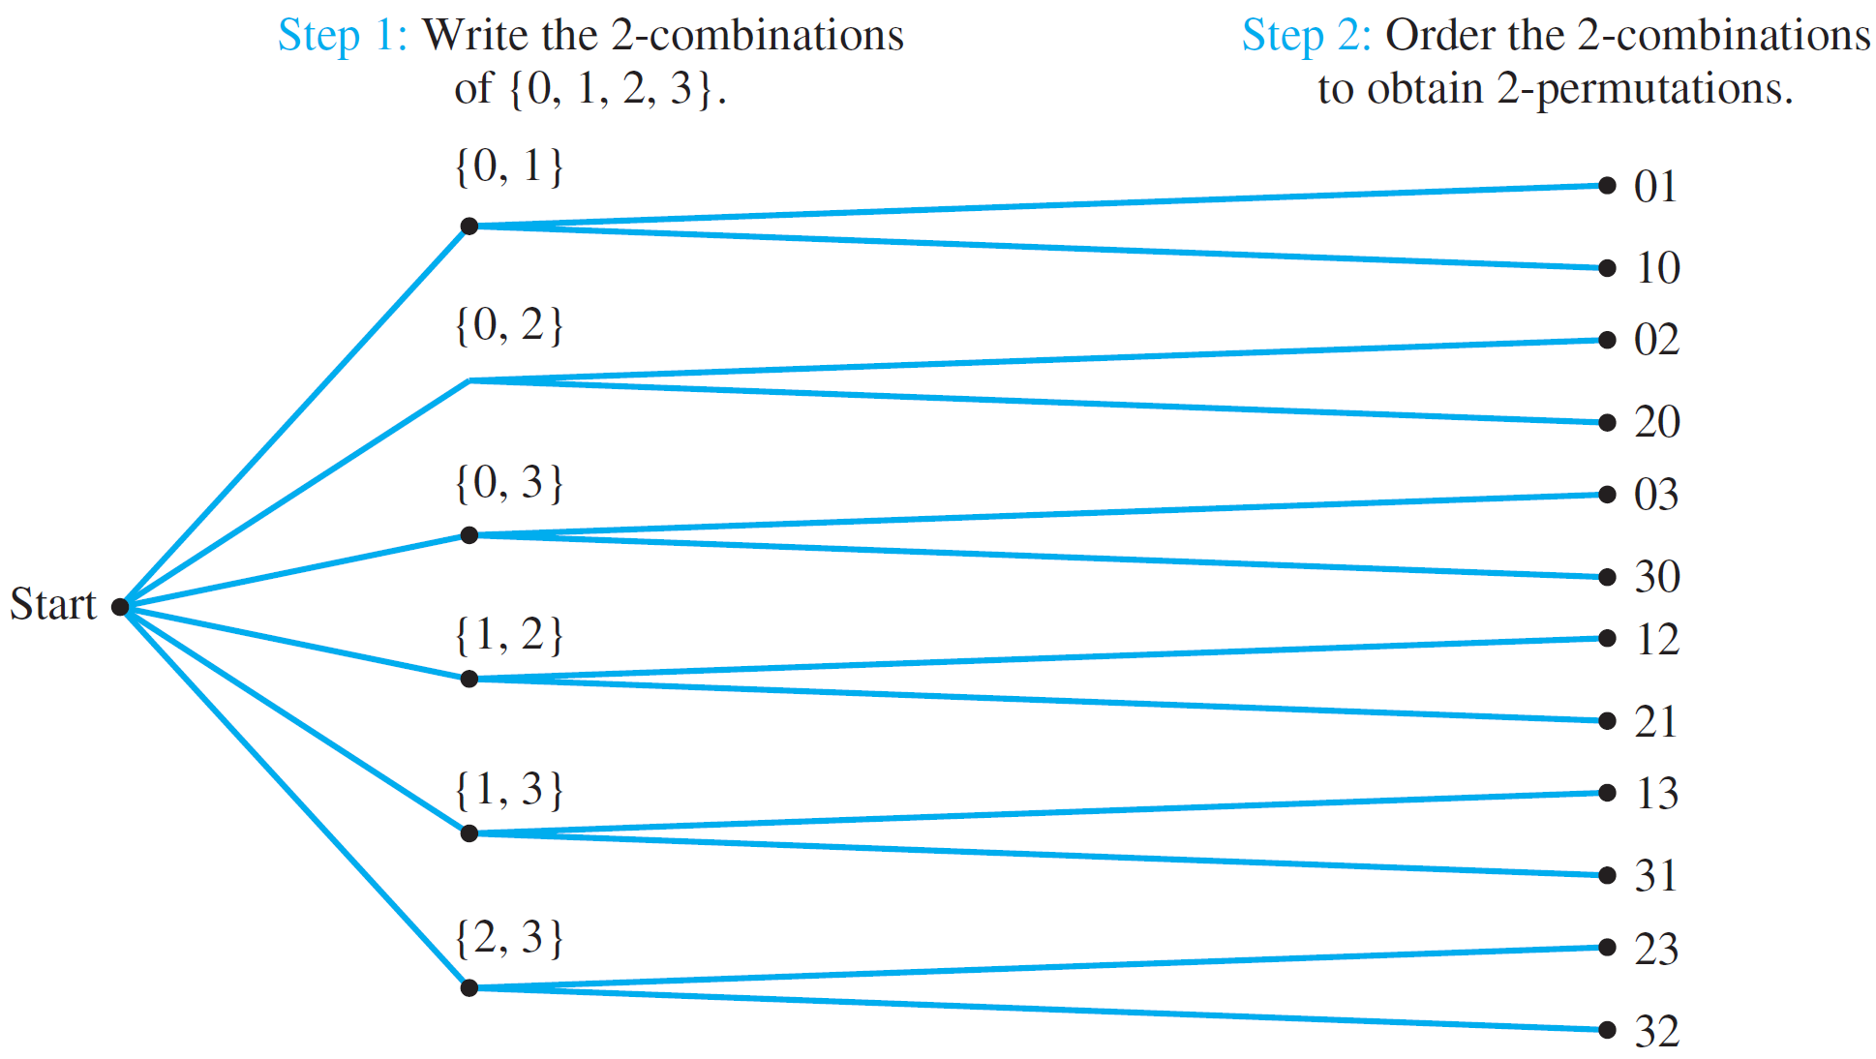
Combinations r-Combinations with Repetition Pascal’s Formula and the Binomial Theorem
Relationship between Permutations and Combinations
Example 3 – Relationship between Permutations and Combinations
This can be illustrated by the following possibility tree:
Figure 9.5.1 Relationship between Permutations and Combinations

Slide 9
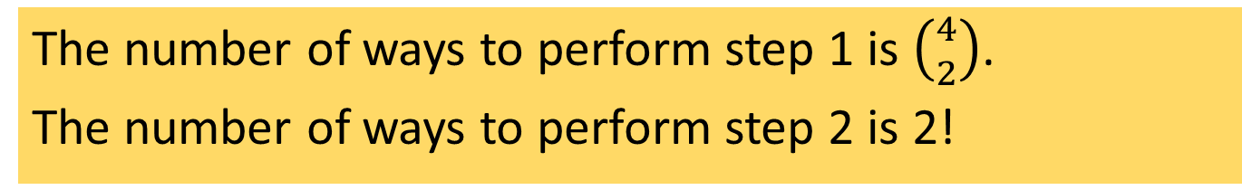
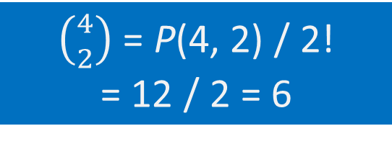

Combinations r-Combinations with Repetition Pascal’s Formula and the Binomial Theorem
Relationship between Permutations and Combinations
Example 3 – Relationship between Permutations and Combinations
The number of ways to perform step 1 is $\left({4 \atop 2}\right)$.
The number of ways to perform step 2 is 2!
Hence,
P(4, 2) = $\left({4 \atop 2}\right)$⋅ 2!
$\left({4 \atop 2}\right)$ = P(4, 2) / 2!
= 12 / 2 = 6

Slide 10


Combinations r-Combinations with Repetition Pascal’s Formula and the Binomial Theorem
Relationship between Permutations and Combinations
Theorem 9.5.1 Formula for $\left({n \atop r}\right)$
The number of subsets of size r (or r-combinations) that can be chosen from a set of n elements, $\left({n \atop r}\right)$, is given by the formula
$\left({n \atop r}\right)= \frac{P(n, r)}{r!}$
or, equivalently,
$\left({n \atop r}\right)= \frac{n!}{r!\left(n−r\right)!}$
where n and r are non-negative integers with r ≤ n.
Recall that
$$P(n,r)=\frac{n!}{\left(n−r\right)!}$$

Slide 11

Combinations r-Combinations with Repetition Pascal’s Formula and the Binomial Theorem
Relationship between Permutations and Combinations
Example 4 – Teams with Members of Two Types
Suppose the group of 12 consists of 5 men and 7 women.
How many 5-person teams can be chosen that consist of 3 men and 2 women?
Hint: Think of it as a two-step process:
Step 1: Choose the men.
Step 2: Choose the women.
$$\left({5 \atop 3}\right)×\left({7 \atop 2}\right)= \frac{5!}{3!2!}×\frac{7!}{2!5!}=210$$


Slide 12

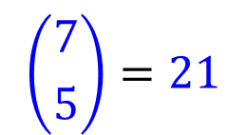
Combinations r-Combinations with Repetition Pascal’s Formula and the Binomial Theorem
Relationship between Permutations and Combinations
Example 4 – Teams with Members of Two Types
Suppose the group of 12 consists of 5 men and 7 women.
How many 5-person teams contain at least one man?
Hint: May use difference rule or addition rule.
The former is shorter for this problem.
Let A be the set of all 5-person teams,
and B be the set of 5-person teams without any men.
$$\left({12 \atop 5}\right)=792$$
$$\left({7 \atop 5}\right)=21$$
Then |A| = , and |B| =
Therefore number of 5-person teams that contain at least one man =
792 – 21 = 771


Slide 13
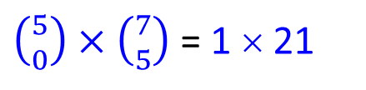
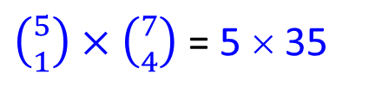
Combinations r-Combinations with Repetition Pascal’s Formula and the Binomial Theorem
Relationship between Permutations and Combinations
Example 4 – Teams with Members of Two Types
Suppose the group of 12 consists of 5 men and 7 women.
How many 5-person teams contain at most one man?
$\left({5 \atop 0}\right)×\left({7 \atop 5}\right)$ = 1 × 21
Number of teams without any man =
= 21
$\left({5 \atop 1}\right)×\left({7 \atop 4}\right)$ = 5 × 35
Number of teams with one man =
= 175
Therefore number of 5-person teams that contain at most one man =
21 + 175 = 196


Slide 14

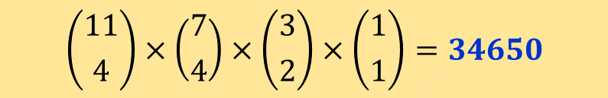



Combinations r-Combinations with Repetition Pascal’s Formula and the Binomial Theorem
Permutations of a Set with Repeated Elements
Example 5 – Permutations of a Set with Repeated Elements
Order the letters in the word
M I S S I S S I P P I
How many distinguishable orderings are there?
Four-step process:
Step 1: Choose a subset of 4 positions for the S’s.
Step 2: Choose a subset of 4 positions for the I’s.
Step 3: Choose a subset of 2 positions for the P’s.
Step 4: Choose a subset of 1 position for the M.
$$\left({11 \atop 4}\right)$$
$$\left({7 \atop 4}\right)$$
$$\left({3 \atop 2}\right)$$
$$\left({1 \atop 1}\right)$$
$$\left({11 \atop 4}\right)×\left({7 \atop 4}\right)×\left({3 \atop 2}\right)×\left({1 \atop 1}\right)=34650$$

Slide 15

Combinations r-Combinations with Repetition Pascal’s Formula and the Binomial Theorem
Permutations of a Set with Repeated Elements
Theorem 9.5.2 Permutations with Sets of Indistinguishable Objects
Suppose a collection consists of n objects of which
n₁ are of type 1 and are indistinguishable from each other
n₂ are of type 2 and are indistinguishable from each other
:
n_{k} are of type k and are indistinguishable from each other
and suppose that n₁ + n₂ + … + n_{k} = n. Then the number of distinguishable permutations of the n objects is
$\left({n \atop n_{1}}\right)\left({n−n_{1} \atop n_{2}}\right)\left({n−n_{1}−n_{2} \atop n_{3}}\right)⋯\left({n−n_{1}−n_{2}−⋯−n_{k−1} \atop n_{k}}\right)$
$= \frac{n!}{n_{1}!n_{2}!n_{3}!⋯n_{k}!}$

Slide 16
Combinations r-Combinations with Repetition Pascal’s Formula and the Binomial Theorem
9.6 r-Combinations with Repetition Allowed

Slide 17

Combinations r-Combinations with Repetition Pascal’s Formula and the Binomial Theorem
r-Combinations with Repetition Allowed
r-Combinations with Repetition Allowed
At a hawker centre there are 6 stalls selling local delights. If you are buying lunch for 20 guests, how many different selections can you make?
Chicken rice
Nasi lemak
Mee rebus
Ayam penyet
Laksa
Bak chor mee

Slide 18

Combinations r-Combinations with Repetition Pascal’s Formula and the Binomial Theorem
r-Combinations with Repetition Allowed
r-Combinations with Repetition Allowed
How many ways are there to choose r elements without regard to order from a set of n elements if repetition is allowed ?
Definition: Multiset
An r-combination with repetition allowed, or multiset of size r, chosen from a set X of n elements is an unordered selection of elements taken from X with repetition allowed.
If X = $\left\{x_{1},x_{2},⋯,x_{n}\right\}$, we write an r-combination with repetition allowed as $\left[x_{i_{1}},x_{i_{2}},⋯,x_{i_{r}}\right]$ where each $x_{i_{j}}$ is in X and some of the $x_{i_{j}}$ may equal each other.

Slide 19
Combinations r-Combinations with Repetition Pascal’s Formula and the Binomial Theorem
r-Combinations with Repetition Allowed
Example 6 – r-Combinations with Repetition Allowed
Write a complete list to find the multisets of size 3 that can be selected from {1, 2, 3, 4}.
All combinations with 1, 1:
[1, 1, 1]; [1, 1, 2]; [1, 1, 3]; [1, 1, 4]
All additional combinations with 1, 2:
[1, 2, 2]; [1, 2, 3]; [1, 2, 4]
All additional combinations with 1, 3:
[1, 3, 3]; [1, 3, 4]
All additional combinations with 1, 4:
[1, 4, 4]
All additional combinations with 2, 2:
[2, 2, 2]; [2, 2, 3]; [2, 2, 4]
All additional combinations with 2, 3:
[2, 3, 3]; [2, 3, 4]
All additional combinations with 2, 4:
[2, 4, 4]
20 3-combinations with repetition allowed.
All additional combinations with 3, 3:
[3, 3, 3]; [3, 3, 4]
All additional combinations with 3, 4:
[3, 4, 4]
All additional combinations with 4, 4:
[4, 4, 4]

Slide 20
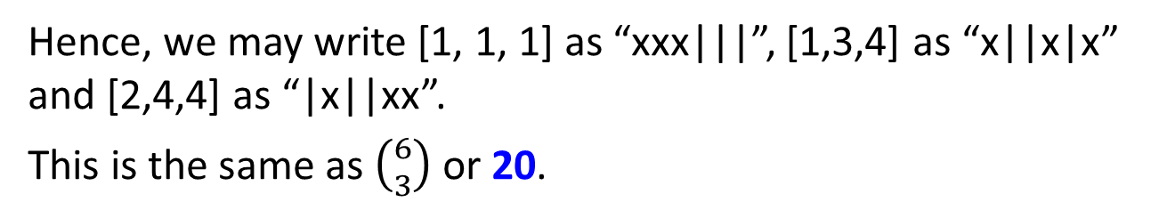
Combinations r-Combinations with Repetition Pascal’s Formula and the Binomial Theorem
r-Combinations with Repetition Allowed
Example 6 – r-Combinations with Repetition Allowed
Consider the numbers 1, 2, 3, 4 in {1, 2, 3, 4} as categories and imagine choosing a total of 3 numbers from the categories with multiple selections from any category allowed.
Category 1
Category 2
Category 3
Category 4
[1, 1, 1]:
xxx
|
|
|
[1, 3, 4]:
x
|
|
x
|
x
[2, 4, 4]:
|
x
|
|
xx
Hence, we may write [1, 1, 1] as “xxx|||”, [1,3,4] as “x||x|x” and [2,4,4] as “|x||xx”.
This is the same as $\left({6 \atop 3}\right)$ or 20.

Slide 21
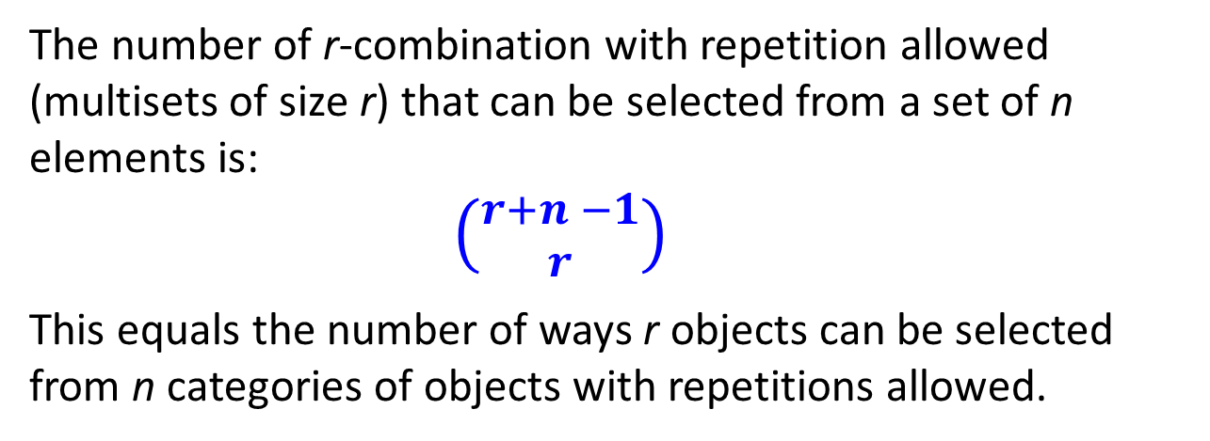
Combinations r-Combinations with Repetition Pascal’s Formula and the Binomial Theorem
r-Combinations with Repetition Allowed
Theorem 9.6.1 Number of r-combinations with Repetition Allowed
The number of r-combination with repetition allowed (multisets of size r) that can be selected from a set of n elements is:
$\left({r+n −1 \atop r}\right)$
This equals the number of ways r objects can be selected from n categories of objects with repetitions allowed.

Slide 22
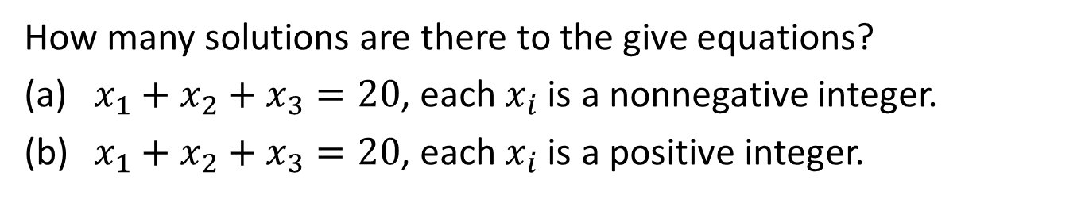
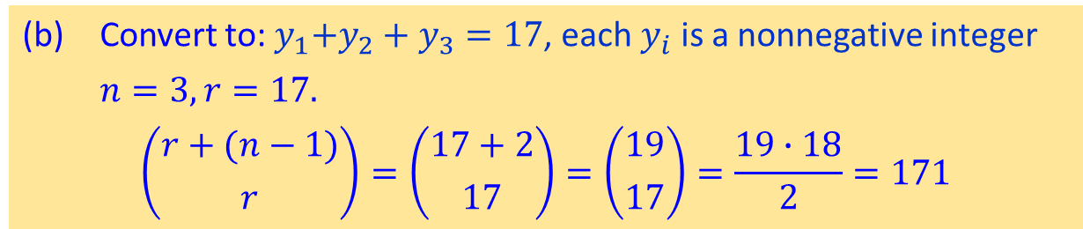
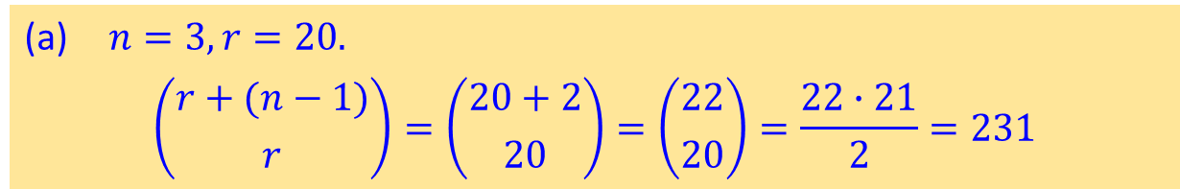
Combinations r-Combinations with Repetition Pascal’s Formula and the Binomial Theorem
r-Combinations with Repetition Allowed
Example 7 – Exercise Set 9.6 Questions 10-11
How many solutions are there to the give equations?
(a) $x_{1}+x_{2}+x_{3}=20$, each $x_{i}$ is a nonnegative integer.
(b) $x_{1}+x_{2}+x_{3}=20$, each $x_{i}$ is a positive integer.
(a) $n=3, r=20.$
$$\left({r+(n−1) \atop r}\right)=\left({20+2 \atop 20}\right)=\left({22 \atop 20}\right)=\frac{22∙21}{2}=231$$
(b) Convert to:${ y}_{1}+y_{2}+y_{3}=17$, each $y_{i}$ is a nonnegative integer
$n=3, r=17.$
$$\left({r+(n−1) \atop r}\right)=\left({17+2 \atop 17}\right)=\left({19 \atop 17}\right)=\frac{19∙18}{2}=171$$


Slide 23
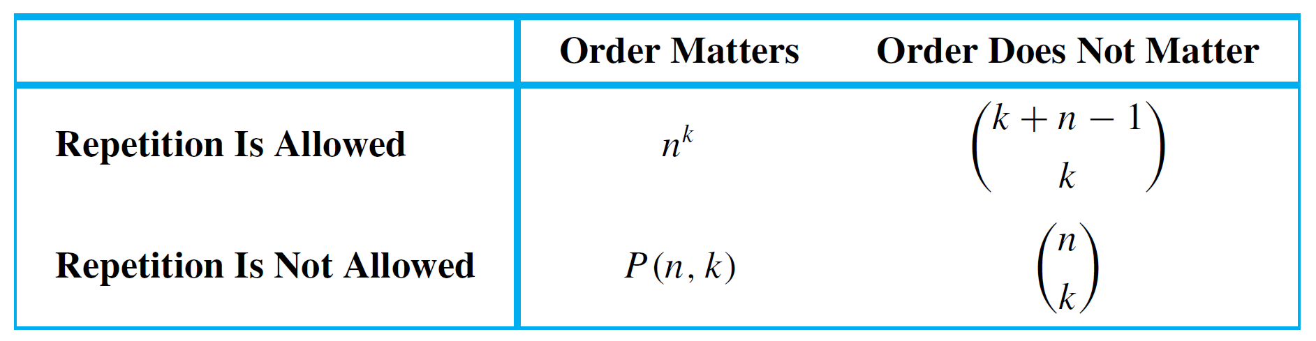
Combinations r-Combinations with Repetition Pascal’s Formula and the Binomial Theorem
Which Formula to Use?
Which Formula to Use?
Earlier we have discussed four different ways of choosing k elements from n. The order in which the choices are made may or may not matter, and repetition may or may not be allowed. The following table summarizes which formula to use in which situation.

Slide 24
Combinations r-Combinations with Repetition Pascal’s Formula and the Binomial Theorem
9.7 Pascal’s Formula and the Binomial Theorem

Slide 25
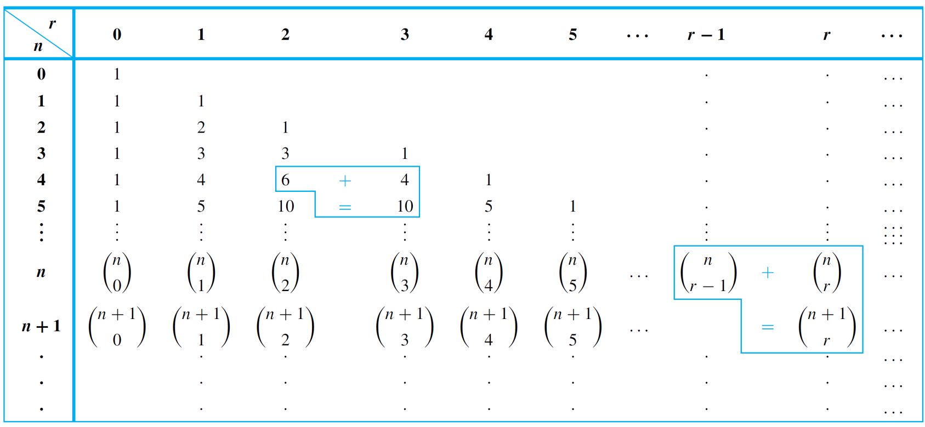
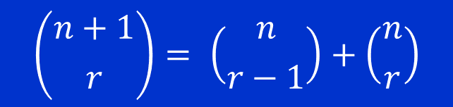
Combinations r-Combinations with Repetition Pascal’s Formula and the Binomial Theorem
Pascal’s Formula
Pascal’s Formula
Suppose n and r are positive integers with r ≤ n. Then
$$\left({n+1 \atop r}\right)= \left({n \atop r−1}\right)+\left({n \atop r}\right)$$
Pascal’s triangle is a geometric version of Pascal’s formula.
Table 9.7.1 Pascal’s Triangle

Slide 26

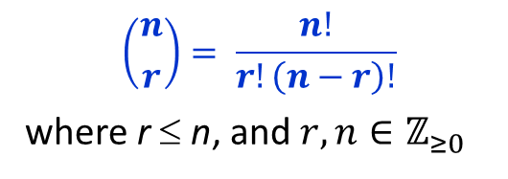

Combinations r-Combinations with Repetition Pascal’s Formula and the Binomial Theorem
Pascal’s Formula
Theorem 9.7.1 Pascal’s Formula
Let n and r be positive integers, r ≤ n. Then
$\left({n+1 \atop r}\right)= \left({n \atop r−1}\right)+\left({n \atop r}\right)$
Pascal’s formula can be derived by two entirely different arguments. One is algebraic; it uses the formula for the number of r-combinations obtained in Theorem 9.5.1.
Theorem 9.5.1 Formula for $\left({n \atop r}\right)$
$$\left({n \atop r}\right)= \frac{n!}{r!\left(n−r\right)!}$$
where r ≤ n, and $r,n∈ℤ_{≥0}$
The other is combinatorial; it uses the definition of the number of r-combinations as the number of subsets of size r taken from a set with a certain number of elements.

Slide 27
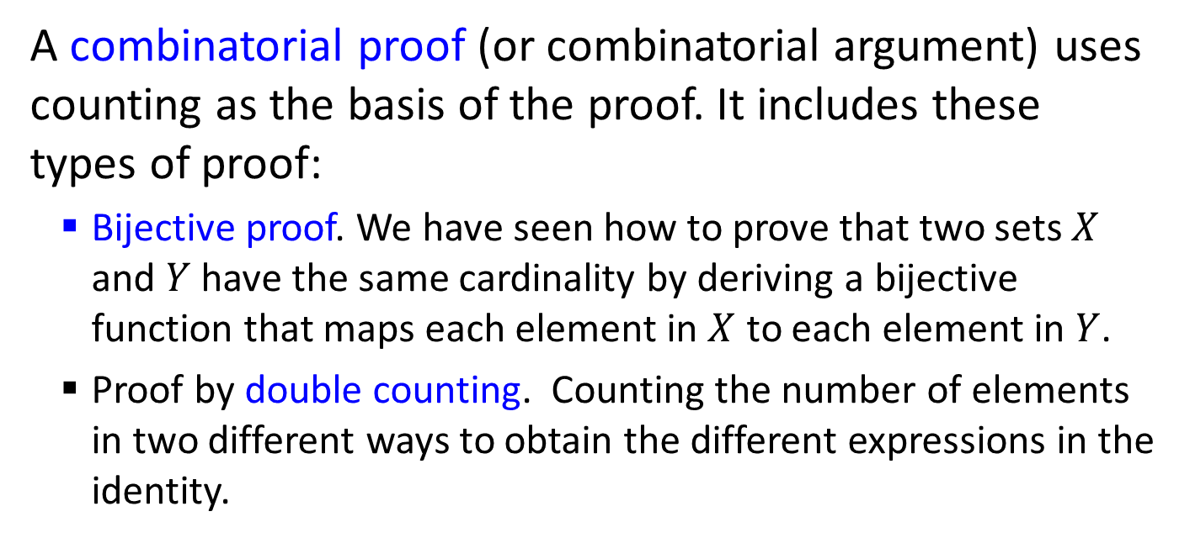
Combinations r-Combinations with Repetition Pascal’s Formula and the Binomial Theorem
Combinatorial Proof
Combinatorial Proof
A combinatorial proof (or combinatorial argument) uses counting as the basis of the proof. It includes these types of proof:
Bijective proof. We have seen how to prove that two sets $X$ and $Y$ have the same cardinality by deriving a bijective function that maps each element in $X$ to each element in $Y$.
Proof by double counting. Counting the number of elements in two different ways to obtain the different expressions in the identity.

Slide 28

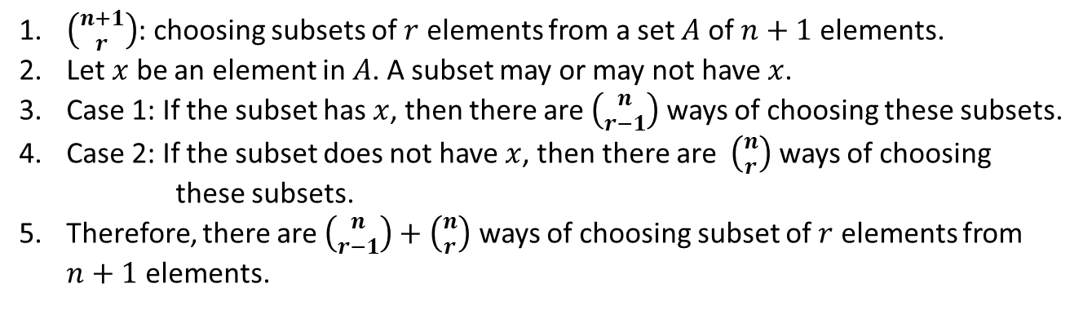
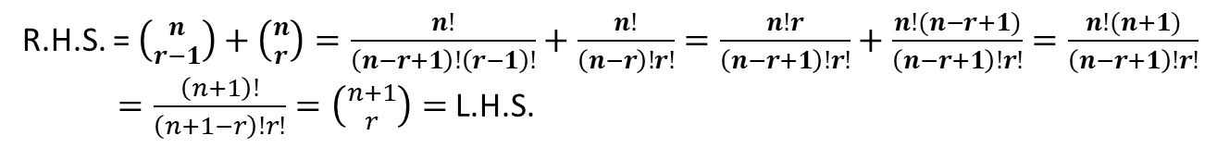
Combinations r-Combinations with Repetition Pascal’s Formula and the Binomial Theorem
Pascal’s Formula
Theorem 9.7.1 Pascal’s Formula
Let n and r be positive integers, r ≤ n. Then
$\left({n+1 \atop r}\right)= \left({n \atop r−1}\right)+\left({n \atop r}\right)$
Algebraic proof:
R.H.S. = $\left({n \atop r−1}\right)+\left({n \atop r}\right)=\frac{n!}{\left(n−r+1\right)!\left(r−1\right)!}+\frac{n!}{\left(n−r\right)!r!}=\frac{n!r}{\left(n−r+1\right)!r!}+\frac{n!(n−r+1)}{\left(n−r+1\right)!r!}=\frac{n!(n+1)}{\left(n−r+1\right)!r!}$
$=\frac{\left(n+1\right)!}{\left(n+1−r\right)!r!}=\left({n+1 \atop r}\right)=$ L.H.S.
Combinatorial proof:
1. $\left({n+1 \atop r}\right)$: choosing subsets of $r$ elements from a set $A$ of $n+1$ elements.
2. Let $x$ be an element in $A$. A subset may or may not have $x$.
3. Case 1: If the subset has $x$, then there are $\left({n \atop r−1}\right)$ ways of choosing these subsets.
4. Case 2: If the subset does not have $x$, then there are $\left({n \atop r}\right)$ ways of choosing these subsets.
5. Therefore, there are $\left({n \atop r−1}\right)+\left({n \atop r}\right)$ ways of choosing subset of $r$ elements from $n+1$ elements.


Slide 29
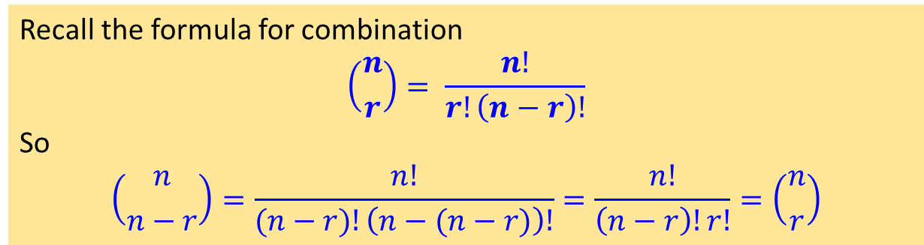
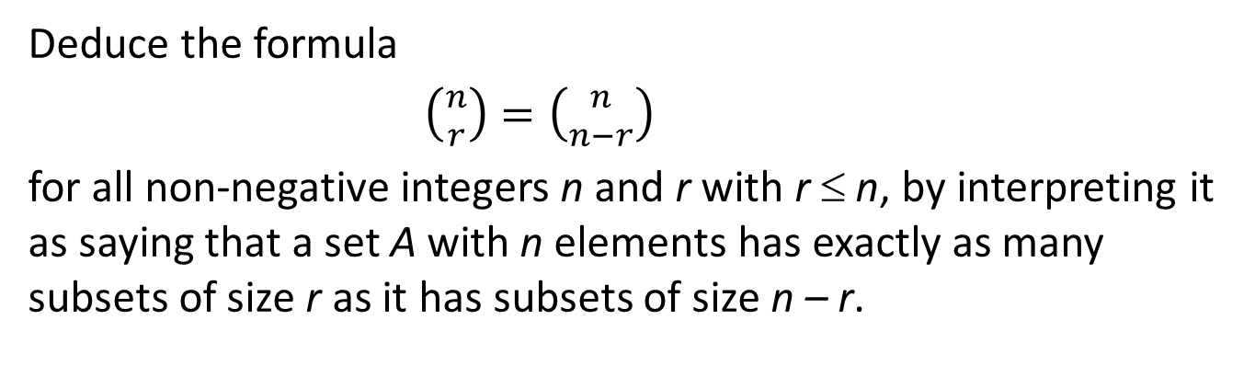
Combinations r-Combinations with Repetition Pascal’s Formula and the Binomial Theorem
$\left({n \atop r}\right)=\left({n \atop n−r}\right)$
Example 8 – Deduce $\left({n \atop r}\right)=\left({n \atop n−r}\right)$
Deduce the formula
$\left({n \atop r}\right)=\left({n \atop n−r}\right)$
for all non-negative integers n and r with r ≤ n, by interpreting it as saying that a set A with n elements has exactly as many subsets of size r as it has subsets of size n – r.
Recall the formula for combination
$$\left({n \atop r}\right)= \frac{n!}{r!\left(n−r\right)!}$$
So
$$\left({n \atop n−r}\right)=\frac{n!}{(n−r)!\left(n−(n−r)\right)!}=\frac{n!}{\left(n−r\right)!r!}=\left({n \atop r}\right)$$

Slide 30
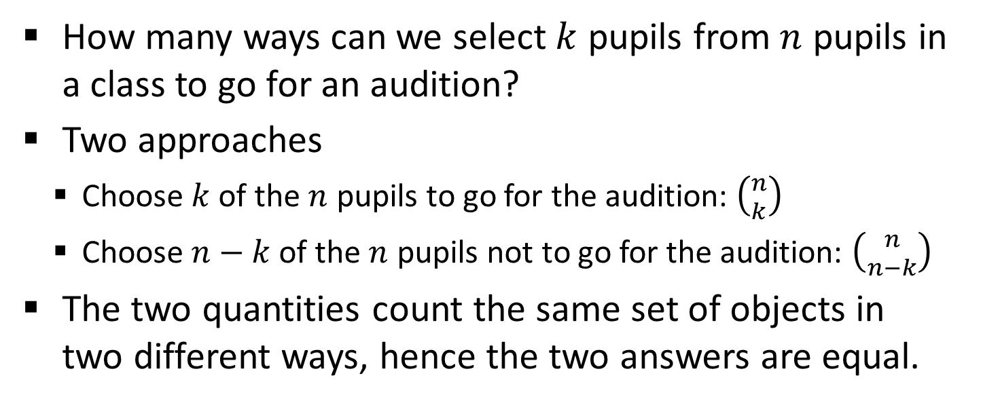
Combinations r-Combinations with Repetition Pascal’s Formula and the Binomial Theorem
Combinatorial Proof
Example 9 – For $0≤k≤n,\left({n \atop k}\right)=\left({n \atop n−k}\right)$
How many ways can we select $k$ pupils from $n$ pupils in a class to go for an audition?
Two approaches
Choose $k$ of the $n$ pupils to go for the audition: $\left({n \atop k}\right)$
Choose $n−k$ of the $n$ pupils not to go for the audition: $\left({n \atop n−k}\right)$
The two quantities count the same set of objects in two different ways, hence the two answers are equal.

Slide 31
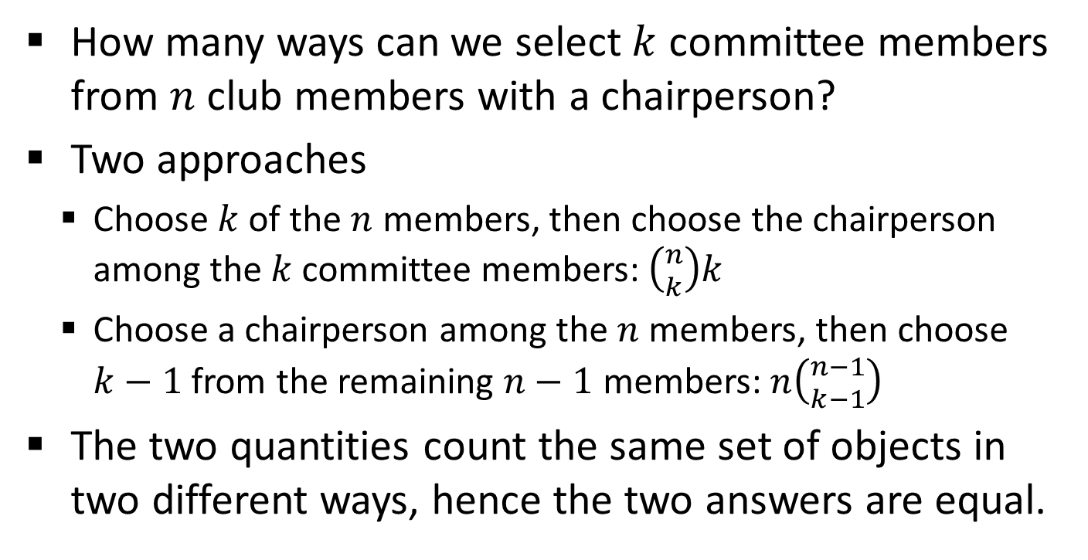
Combinations r-Combinations with Repetition Pascal’s Formula and the Binomial Theorem
Combinatorial Proof
Example 10 – For $0≤k≤n,k\left({n \atop k}\right)=n\left({n−1 \atop k−1}\right)$
How many ways can we select $k$ committee members from $n$ club members with a chairperson?
Two approaches
Choose $k$ of the $n$ members, then choose the chairperson among the $k$ committee members: $\left({n \atop k}\right)k$
Choose a chairperson among the $n$ members, then choose $k−1$ from the remaining $n−1$ members: $n\left({n−1 \atop k−1}\right)$
The two quantities count the same set of objects in two different ways, hence the two answers are equal.

Slide 32
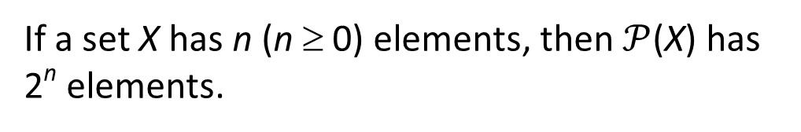
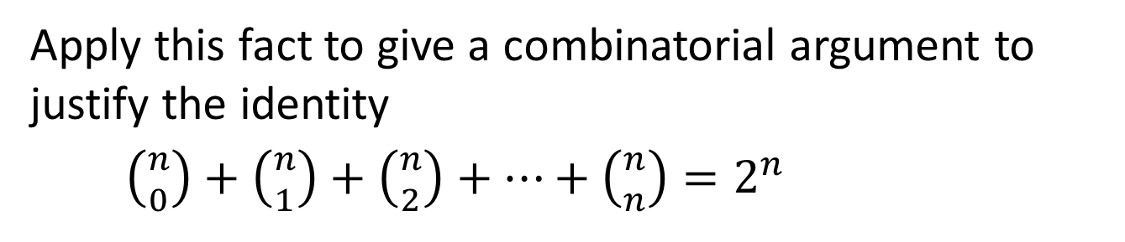
Combinations r-Combinations with Repetition Pascal’s Formula and the Binomial Theorem
Combinatorial Proof
Example 11 – Using Combinatorial Argument to Derive some Identity
According to Theorem 6.3.1, a set with n elements has 2^{n} subsets.
Theorem 6.3.1 Number of elements in a Power Set
If a set X has n (n ≥ 0) elements, then $𝒫$(X) has 2^{n} elements.
Apply this fact to give a combinatorial argument to justify the identity
$\left({n \atop 0}\right)+\left({n \atop 1}\right)+\left({n \atop 2}\right)+⋯+\left({n \atop n}\right)=2^{n}$

Slide 33
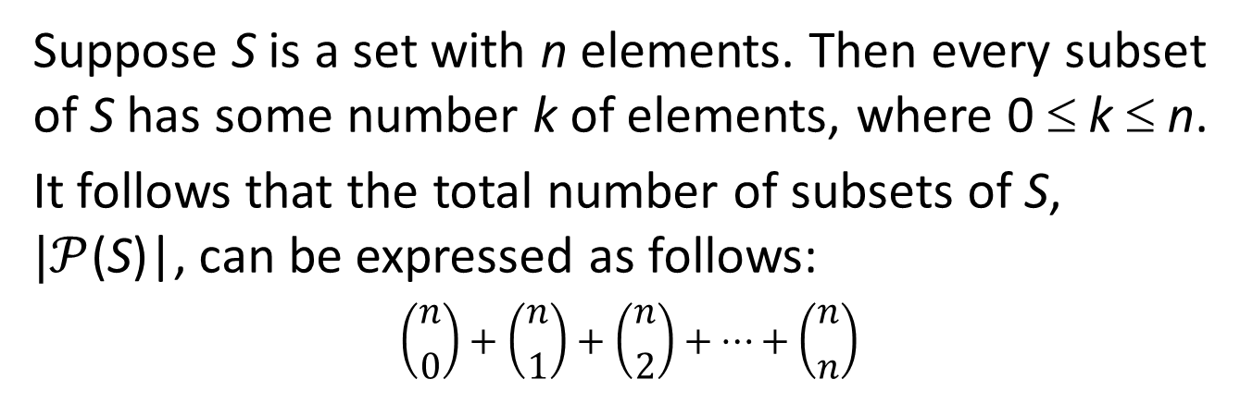
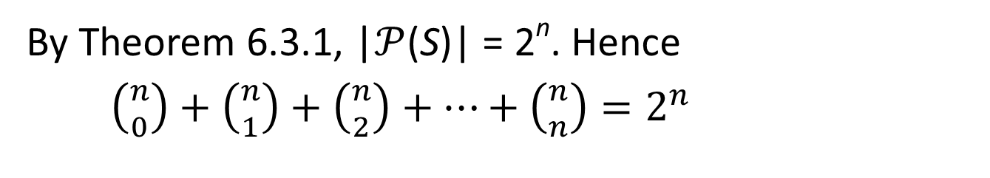
Combinations r-Combinations with Repetition Pascal’s Formula and the Binomial Theorem
Combinatorial Proof
Example 11 – Using Combinatorial Argument to Derive some Identity
Suppose S is a set with n elements. Then every subset of S has some number k of elements, where 0 ≤ k ≤ n.
It follows that the total number of subsets of S, $|𝒫$(S)|, can be expressed as follows:
$$\left({n \atop 0}\right)+\left({n \atop 1}\right)+\left({n \atop 2}\right)+⋯+\left({n \atop n}\right)$$
By Theorem 6.3.1, |$𝒫$(S)| = 2^{n}. Hence
$\left({n \atop 0}\right)+\left({n \atop 1}\right)+\left({n \atop 2}\right)+⋯+\left({n \atop n}\right)=2^{n}$

Slide 34
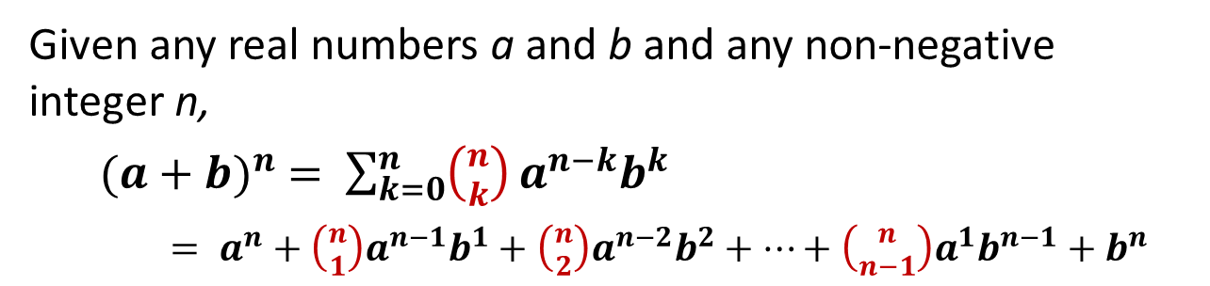
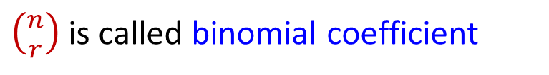
Combinations r-Combinations with Repetition Pascal’s Formula and the Binomial Theorem
The Binomial Theorem
The Binomial Theorem
In algebra a sum of two terms, such as a + b, is called binomial.
The binomial theorem gives an expression for the powers of a binomial (a + b)^{n}, for each positive integer n and all real numbers a and b.
$\left({n \atop r}\right)$is called binomial coefficient
Theorem 9.7.2 Binomial Theorem
Given any real numbers a and b and any non-negative integer n,
${(a+b)}^{n} = \sum_{k=0}^{n}{\left({n \atop k}\right)}a^{n−k}b^{k}$
$= a^{n}+\left({n \atop 1}\right)a^{n−1}b^{1}+\left({n \atop 2}\right)a^{n−2}b^{2}+⋯+\left({n \atop n−1}\right)a^{1}b^{n−1}+b^{n}$

Slide 35
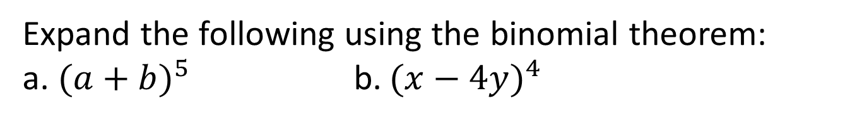
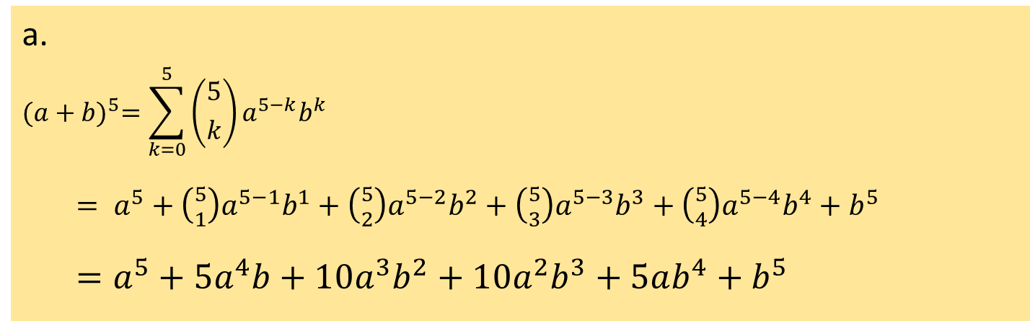
Combinations r-Combinations with Repetition Pascal’s Formula and the Binomial Theorem
The Binomial Theorem
Example 12 – Substituting into the Binomial Theorem
Expand the following using the binomial theorem:
a. ${(a+b)}^{5}$ b. ${(x−4y)}^{4}$
a.
$${(a+b)}^{5}=\sum_{k=0}^{5}{\left({5 \atop k}\right)}a^{5−k}b^{k}$$
$= a^{5}+\left({5 \atop 1}\right)a^{5−1}b^{1}+\left({5 \atop 2}\right)a^{5−2}b^{2}+\left({5 \atop 3}\right)a^{5−3}b^{3}+\left({5 \atop 4}\right)a^{5−4}b^{4}+b^{5}$
$=a^{5}+5a^{4}b+10a^{3}b^{2}+10a^{2}b^{3}+5ab^{4}+b^{5}$

Slide 36
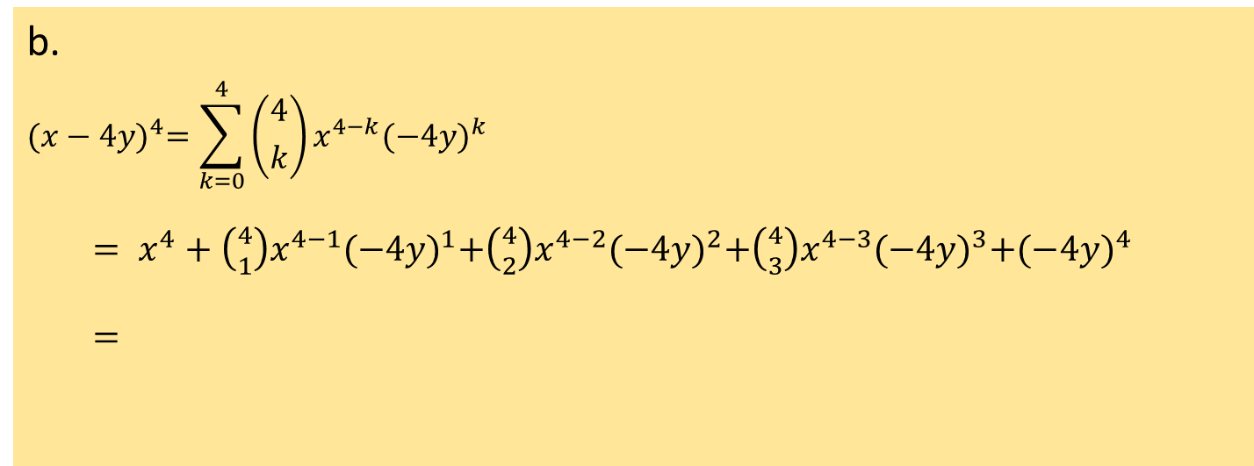
Combinations r-Combinations with Repetition Pascal’s Formula and the Binomial Theorem
The Binomial Theorem
Example 12 – Substituting into the Binomial Theorem
Expand the following using the binomial theorem:
a. ${(a+b)}^{5}$ b. ${(x−4y)}^{4}$
b.
$${(x−4y)}^{4}=\sum_{k=0}^{4}{\left({4 \atop k}\right)}x^{4−k}{(−4y)}^{k}$$
$= x^{4}+\left({4 \atop 1}\right)x^{4−1}{(−4y)}^{1}+\left({4 \atop 2}\right)x^{4−2}{(−4y)}^{2}+\left({4 \atop 3}\right)x^{4−3}{(−4y)}^{3}+{(−4y)}^{4}$
$=$
$$x^{4}+4x^{3}\left(−4y\right)+6x^{2}16y^{2}+4x(−64y^{3})+256y^{4}$$
$${=x}^{4}−16x^{3}y+96x^{2}y^{2}−256xy^{3}+256y^{4}$$


Slide 37
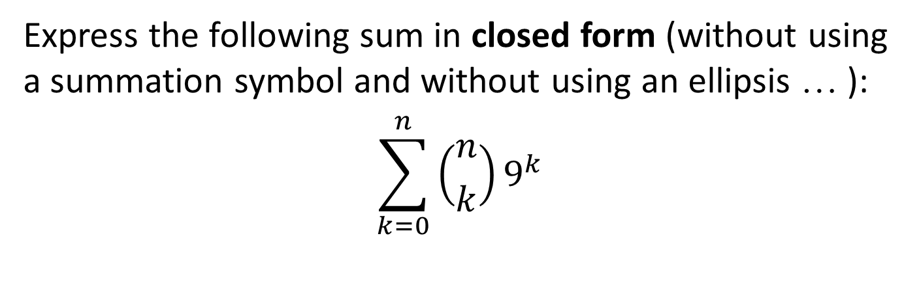
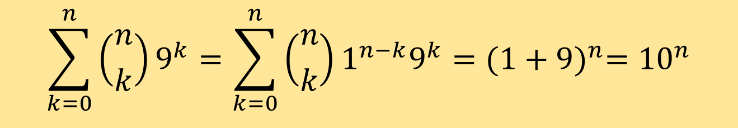
Combinations r-Combinations with Repetition Pascal’s Formula and the Binomial Theorem
The Binomial Theorem
Example 13 – Using the Binomial Theorem to Simplify a Sum
Express the following sum in closed form (without using a summation symbol and without using an ellipsis … ):
$$\sum_{k=0}^{n}{\left({n \atop k}\right)}9^{k}$$
$$\sum_{k=0}^{n}{\left({n \atop k}\right)}9^{k}=\sum_{k=0}^{n}{\left({n \atop k}\right)}1^{n−k}9^{k}={(1+9)}^{n}={10}^{n}$$

Slide 38
Probability Axioms and Expected Value Conditional Probability, Bayes’ Formula, and Independent Events
9.8 Probability Axioms and Expected Value

Slide 39
Probability Axioms and Expected Value Conditional Probability, Bayes’ Formula, and Independent Events
Probability Axioms
Probability Axioms
Recall: a sample space is a set of all outcomes of a random process or experiment and that an event is a subset of a sample space.
Probability Axioms
Let S be a sample space. A probability function P from the set of all events in S to the set of real numbers satisfies the following axioms: For all events A and B in S,
0 ≤ P(A) ≤ 1
P(∅) = 0 and P(S) = 1
If A and B are disjoint events (A ∩ B = ∅), then
P(A ∪ B) = P(A) + P(B)

Slide 40
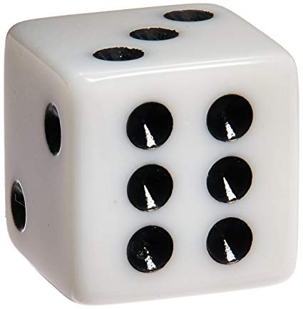


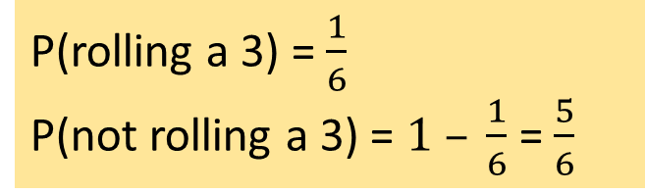
Probability Axioms and Expected Value Conditional Probability, Bayes’ Formula, and Independent Events
Probability Axioms
Probability of the Complement of an Event
Probability of the Complement of an Event
If A is any event in a sample space S, then
$P\left(\overline{A}\right)=1 −P(A)$
Example: You roll a fair die, what is the probability of not rolling a 3?
P(rolling a 3) = $\frac{1}{6}$
P(not rolling a 3) = $1 – \frac{1}{6}$ = $\frac{5}{6}$
Note: Epps uses $A^{c}$ to represent the complement of event $A$.
We will use $\overline{A}$ to be consistent with the notation used in sets.

Slide 41

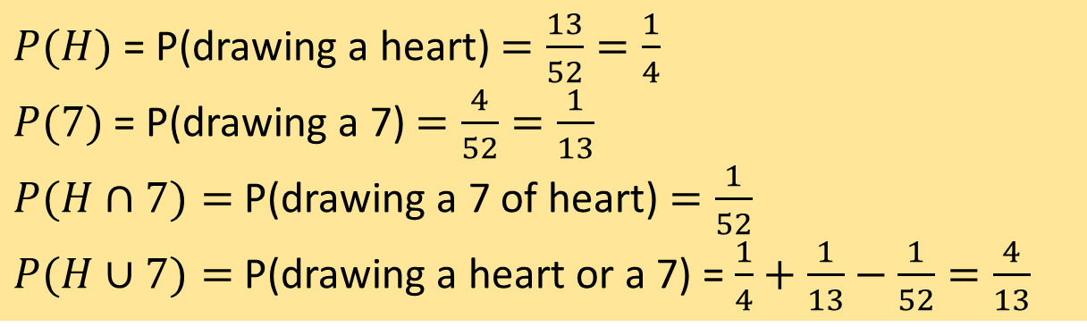
Probability Axioms and Expected Value Conditional Probability, Bayes’ Formula, and Independent Events
Probability Axioms
Probability of a General Union of Two Events
Probability of a General Union of Two Events
If A and B are any events in a sample space S, then
P(A ∪ B) = P(A) + P(B) – P(A ∩ B).
Example: A card is drawn from a standard deck. What is the probability of drawing a heart or a 7?
$P(H)$= P(drawing a heart) $=\frac{13}{52}=\frac{1}{4}$
$P(7)$= P(drawing a 7) $=\frac{4}{52}=\frac{1}{13}$
$P(H∩7)=$ P(drawing a 7 of heart) $=\frac{1}{52}$
$P(H∪7)=$ P(drawing a heart or a 7) = $\frac{1}{4}+\frac{1}{13}−\frac{1}{52}=\frac{4}{13}$

Slide 42

Probability Axioms and Expected Value Conditional Probability, Bayes’ Formula, and Independent Events
Expected Value
Expected Value
People who buy lottery tickets regularly often justify the practice by saying that, even though they know that on average they will lose money, they are hoping for one significant gain, after which they believe they will quit playing.
Unfortunately, when people who have lost money on a string of losing lottery tickets win some or all of it back, they generally decide to keep trying their luck instead of quitting.

Slide 43
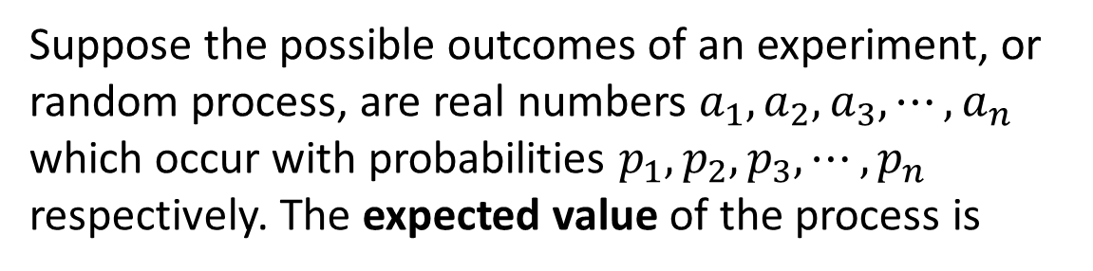
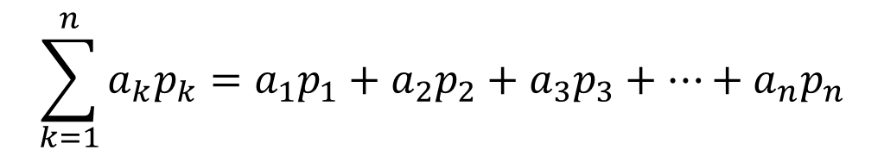
Probability Axioms and Expected Value Conditional Probability, Bayes’ Formula, and Independent Events
Expected Value
The technical way to say that on average a person will lose money on the lottery is to say that the expected value of playing the lottery is negative.
Definition: Expected Value
Suppose the possible outcomes of an experiment, or random process, are real numbers $a_{1},a_{2},a_{3},⋯,a_{n}$ which occur with probabilities $p_{1},p_{2},p_{3},⋯,p_{n}$ respectively. The expected value of the process is
$$\sum_{k=1}^{n}{a_{k}p_{k}=a_{1}p_{1}+a_{2}p_{2}+a_{3}p_{3}+⋯+a_{n}p_{n}}$$

Slide 44

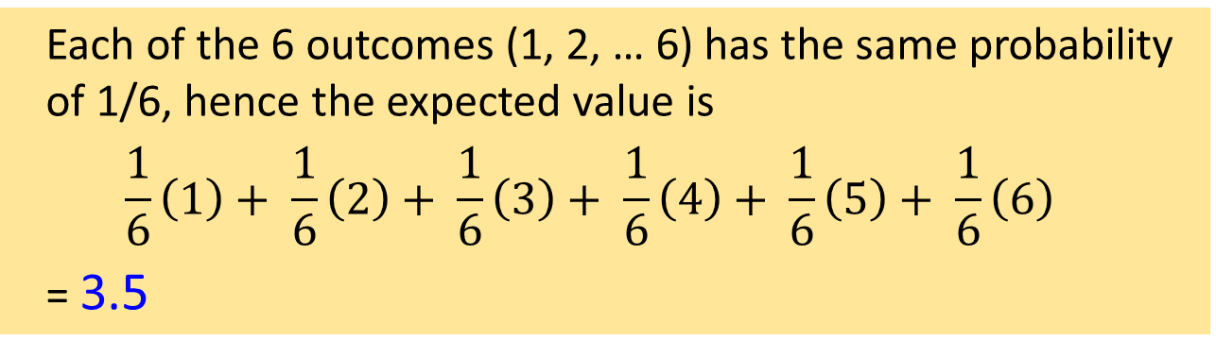
Probability Axioms and Expected Value Conditional Probability, Bayes’ Formula, and Independent Events
Expected Value
Example 14 – Expected Value of a Die
If you roll a fair die, what is the expected value?
Each of the 6 outcomes (1, 2, … 6) has the same probability of 1/6, hence the expected value is
$$\frac{1}{6}\left(1\right)+ \frac{1}{6}\left(2\right)+ \frac{1}{6}\left(3\right)+ \frac{1}{6}\left(4\right)+ \frac{1}{6}\left(5\right)+ \frac{1}{6}\left(6\right)$$
= 3.5

Slide 45
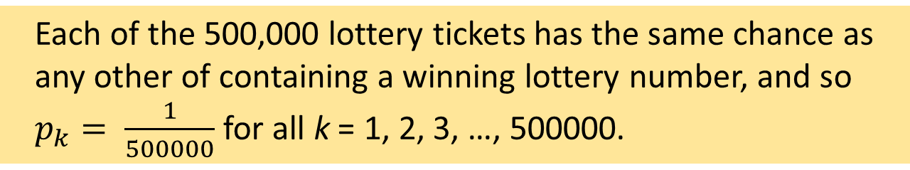
Probability Axioms and Expected Value Conditional Probability, Bayes’ Formula, and Independent Events
Expected Value
Example 15 – Expected Value of a Lottery
Suppose that 500,000 people pay $5 each to play a lottery game with the following prizes:
A grand prize of $1,000,000,
10 second prizes of $1,000 each,
1,000 third prizes of $500 each, and
10,000 fourth prizes of $10 each.
What is the expected value of a ticket?
Each of the 500,000 lottery tickets has the same chance as any other of containing a winning lottery number, and so $p_{k}= \frac{1}{500000}$ for all k = 1, 2, 3, …, 500000.

Slide 46
Probability Axioms and Expected Value Conditional Probability, Bayes’ Formula, and Independent Events
Expected Value
Example 15 – Expected Value of a Lottery
A grand prize of $1,000,000,
10 second prizes of $1,000 each,
1,000 third prizes of $500 each, and
10,000 fourth prizes of $10 each.
Let a₁, a₂, a₃, …, a₅₀₀₀₀₀ be the net gain for an individual ticket, where a₁ = 999995.
a₂ = a₃ = … = a₁₁ = 995 (the net gain for each of the 10 second prize tickets)
a₁₂ = a₁₃ = … = a₁₀₁₁ = 495 (the net gain for each of the 1000 third prize tickets)
a₁₀₁₂ = a₁₀₁₃ = … = a₁₁₀₁₁ = 5 (the net gain for each of the 10000 fourth prize tickets)
a₁₁₀₁₂ = a₁₁₀₁₃ = … = a₅₀₀₀₀₀ = –5 (the remaining 488989 tickets lose $5)

Slide 47
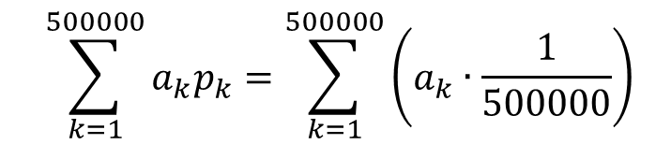

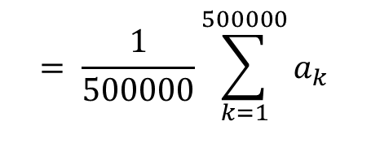
Probability Axioms and Expected Value Conditional Probability, Bayes’ Formula, and Independent Events
Expected Value
Example 15 – Expected Value of a Lottery
A grand prize of $1,000,000,
10 second prizes of $1,000 each,
1,000 third prizes of $500 each, and
10,000 fourth prizes of $10 each.
The expected value of a ticket is therefore:
$$\sum_{k=1}^{500000}{a_{k}p_{k}}=\sum_{k=1}^{500000}{\left(a_{k}∙\frac{1}{500000}\right)}$$
In other words, a person who continues to play this lottery for a very long time will probably win some money occasionally but on average will lose $1.78 per ticket.
$$= \frac{1}{500000}\sum_{k=1}^{500000}{a_{k}}$$
$$= \frac{1}{500000}(999995+10∙995+1000∙495+10000∙5+488989∙(−5))$$
$$=−1.78$$


Slide 48


Probability Axioms and Expected Value Conditional Probability, Bayes’ Formula, and Independent Events
Linearity of Expectation
Linearity of Expectation
The expected value of the sum of random variables is equal to the sum of their individual expected values, regardless of whether they are independent.
For random variables $X$ and $Y$ (which may be dependent),
$$E\left[X+Y\right]=E\left[X\right]+E[Y]$$
More generally, for random variables $X_{1},X_{2},⋯,X_{n}$ and constants $c_{1},c_{2},⋯,c_{n}$,
$$E\left[\sum_{i=1}^{n}{c_{i}{∙X}_{i}}\right]=\sum_{i=1}^{n}{\left(c_{i}∙E[X_{i}]\right)}$$

Slide 49



Probability Axioms and Expected Value Conditional Probability, Bayes’ Formula, and Independent Events
Linearity of Expectation
Example 16 – Expected Value of Sum of Two Dice
Calculating the expected value of the sum of two dice using basic method is tedious.
Using linearity of expectation, the expected value for the sum of two dice = 3.5 + 3.5 = 7
Credit: brilliant.org
Check: Let $s$ be the sum of two dice values
$P\left(s=2\right)=\frac{1}{36}; P\left(s=3\right)=\frac{2}{36};P\left(s=4\right)=\frac{3}{36};P\left(s=5\right)=\frac{4}{36};P\left(s=6\right)=\frac{5}{36};$ $P\left(s=7\right)=\frac{6}{36};$
$$P\left(s=8\right)=\frac{5}{36};P\left(s=9\right)=\frac{4}{36};P\left(s=10\right)=\frac{3}{36};P\left(s=11\right)=\frac{2}{36}; P\left(s=12\right)=\frac{1}{36};$$
Expected value = $2∙\frac{1}{36}+3∙\frac{2}{36}+4∙\frac{3}{36}+5∙\frac{4}{36}+6∙\frac{5}{36}+7∙\frac{6}{36}+8∙\frac{5}{36}+9∙\frac{4}{36}+10∙\frac{3}{36}+11∙\frac{2}{36}+12∙\frac{1}{36}=7$

Slide 50
Probability Axioms and Expected Value Conditional Probability, Bayes’ Formula, and Independent Events
9.9 Conditional Probability, Bayes’ Formula, and Independent Events

Slide 51


Probability Axioms and Expected Value Conditional Probability, Bayes’ Formula, and Independent Events
Conditional Probability
Conditional Probability
Imagine a couple with two children, each of whom is equally likely to be a boy or a girl. Now suppose you are given the information that one is a boy. What is the probability that the other child is a boy?
New sample space = gray region.
Figure 9.9.1

Slide 52


Probability Axioms and Expected Value Conditional Probability, Bayes’ Formula, and Independent Events
Conditional Probability
Within the new sample space, there is one combination where the other child is a boy (blue-gray region).
Hence, the likelihood that the other child is a boy given that at least one is a boy = 1/3.
Figure 9.9.1
Note also

Slide 53



Probability Axioms and Expected Value Conditional Probability, Bayes’ Formula, and Independent Events
Conditional Probability
A generalization of this observation forms the basis for the following definition.
Definition: Conditional Probability
Let A and B be events in a sample space S. If P(A) ≠ 0, then the conditional probability of B given A, denoted P(B|A), is
$$P(B|A)=\frac{P(A∩B)}{P(A)}$$
9.9.1
Multiplying both sides of formula 9.9.1 by P(A), we get
Dividing both sides of formula 9.9.2 by P(B|A), we get
$$P(A∩B)=P(B|A)∙P(A)$$
$$P(A)=\frac{P(A∩B)}{P(B|A)}$$
9.9.2
9.9.3

Slide 54

Probability Axioms and Expected Value Conditional Probability, Bayes’ Formula, and Independent Events
Conditional Probability
Example 17 – Representing Conditional Probabilities in a Tree Diagram
An urn contains 5 blue and 7 gray balls. Let us say that 2 balls are chosen at random, one after the other, without replacement.
Find the following probabilities and illustrate them with a tree diagram: the probability that both balls are blue, the probability that the first ball is blue and the second is not blue, the probability that the first ball is not blue and the second ball is blue, and the probability that neither ball is blue.
What is the probability that the second ball is blue?
What is the probability that at least one of the balls is blue?
If the experiment of choosing two balls from the urn were repeated many times over, what would be the expected value of the number of blue balls?

Slide 55

Probability Axioms and Expected Value Conditional Probability, Bayes’ Formula, and Independent Events
Conditional Probability
Example 17 – Representing Conditional Probabilities in a Tree Diagram
An urn contains 5 blue and 7 gray balls. Let us say that 2 balls are chosen at random, one after the other, without replacement.
Let
S denote the sample space of all possible choices of two balls from the urn,
B₁ be the event that the first ball is blue (then $\overline{B_{1}}$ is the event that the first ball is not blue),
B₂ be the event that the second ball is blue (then $\overline{B_{2}}$ is the event that the second ball is not blue).

Slide 56
Probability Axioms and Expected Value Conditional Probability, Bayes’ Formula, and Independent Events
Conditional Probability
Example 17 – Representing Conditional Probabilities in a Tree Diagram
An urn contains 5 blue and 7 gray balls. Let us say that 2 balls are chosen at random, one after the other, without replacement.
Find the following probabilities and illustrate them with a tree diagram: the probability that both balls are blue, the probability that the first ball is blue and the second is not blue, the probability that the first ball is not blue and the second ball is blue, and the probability that neither ball is blue.

Slide 57











Probability Axioms and Expected Value Conditional Probability, Bayes’ Formula, and Independent Events
Conditional Probability
Example 17 – Representing Conditional Probabilities in a Tree Diagram
5 blue, 7 gray.
Find $P(B_{1}∩B_{2})$, $P(B_{1}∩\overline{B_{2}})$, $P(\overline{B_{1}}∩B_{2})$, $P(\overline{B_{1}}∩\overline{B_{2}})$.
$$P(B_{1})=\frac{5}{12}$$
$$P(\overline{B_{1}})=\frac{7}{12}$$
$$P({B_{2}|B}_{1})=\frac{4}{11}$$
$$P({\overline{B_{2}}|B}_{1})=\frac{7}{11}$$
By formula 9.9.2
$$P(B_{2}|\overline{B_{1}})=\frac{5}{11}$$
$$P(\overline{B_{2}}|\overline{B_{1}})=\frac{6}{11}$$
$$P(A∩B)=P(B|A)∙P(A)$$
$$P\left(B_{1}∩B_{2}\right)=P\left(B_{2} | B_{1}\right)∙P\left(B_{1}\right)=\frac{4}{11}∙\frac{5}{12}=\frac{20}{132}$$
$$P\left(B_{1}∩\overline{B_{2}}\right)=P\left(\overline{B_{2}} | B_{1}\right)∙P\left(B_{1}\right)=\frac{7}{11}∙\frac{5}{12}=\frac{35}{132}$$
$$P\left({\overline{B_{1}}∩B}_{2}\right)=P\left(B_{2} | \overline{B_{1}}\right)∙P\left(\overline{B_{1}}\right)=\frac{5}{11}∙\frac{7}{12}=\frac{35}{132}$$
$$P\left(\overline{B_{1}}∩\overline{B_{2}}\right)=P\left(\overline{B_{2}} | \overline{B_{1}}\right)∙P\left(\overline{B_{1}}\right)=\frac{6}{11}∙\frac{7}{12}=\frac{42}{132}$$

Slide 58


Probability Axioms and Expected Value Conditional Probability, Bayes’ Formula, and Independent Events
Conditional Probability
Example 17 – Representing Conditional Probabilities in a Tree Diagram
5 blue, 7 gray.
Find $P(B_{1}∩B_{2})$, $P(B_{1}∩\overline{B_{2}})$, $P(\overline{B_{1}}∩B_{2})$, $P(\overline{B_{1}}∩\overline{B_{2}})$.
2
Note: Textbook uses $E^{c}$ to denote $\overline{E}$.
Figure 9.9.2

Slide 59



Probability Axioms and Expected Value Conditional Probability, Bayes’ Formula, and Independent Events
Conditional Probability
Example 17 – Representing Conditional Probabilities in a Tree Diagram
5 blue, 7 gray.
What is the probability that the 2nd ball is blue?
First ball is blue and second is also blue, OR
first ball is gray and second is blue.
Note that they are mutually exclusive.
$$P\left(B_{2}\right)=P(\left(B_{2}∩B_{1}\right)∪\left(B_{2}∩\overline{B_{1}}\right))$$
$$=P\left(B_{2}∩B_{1}\right)+P\left(B_{2}∩\overline{B_{1}}\right)$$
by probability axiom 3
$$=\frac{20}{132}+\frac{35}{132}= \frac{55}{132}=\frac{5}{12}$$

Slide 60

Probability Axioms and Expected Value Conditional Probability, Bayes’ Formula, and Independent Events
Conditional Probability
Example 17 – Representing Conditional Probabilities in a Tree Diagram
5 blue, 7 gray.
What is the probability that at least one ball is blue?
Probability of a General Union of Two Events
If A and B are any events in a sample space S, then
P(A ∪ B) = P(A) + P(B) – P(A ∩ B).
$$P\left(B_{1}∪B_{2}\right)=P\left(B_{1}\right)+P\left(B_{2}\right)− P\left(B_{1}∩B_{2}\right)$$
$$=\frac{5}{12}+\frac{5}{12}− \frac{20}{132}= \frac{90}{132}=\frac{15}{22}$$


Slide 61


Probability Axioms and Expected Value Conditional Probability, Bayes’ Formula, and Independent Events
Conditional Probability
Example 17 – Representing Conditional Probabilities in a Tree Diagram
5 blue, 7 gray.
The expected value of the number of blue balls?
$$=1−\frac{15}{22}=\frac{7}{22}$$
P(no blue balls) = 1 – P(at least one blue ball)
The event that one ball is blue → first ball is blue but second ball is not; or second ball is blue but first ball is not.
From part (a), $P\left(B_{1}∩\overline{B_{2}}\right)=\frac{35}{132}$ and $P\left(\overline{B_{1}}∩B_{2}\right)=\frac{35}{132}$
Hence, P(1 blue ball) $=\frac{35}{132}+ \frac{35}{132}=\frac{70}{132}$
From part (a), P(2 blue balls) $=\frac{20}{132}$

Slide 62





Probability Axioms and Expected Value Conditional Probability, Bayes’ Formula, and Independent Events
Conditional Probability
Example 17 – Representing Conditional Probabilities in a Tree Diagram
5 blue, 7 gray.
The expected value of the number of blue balls?
P(no blue balls) = $\frac{7}{22}$
P(1 blue ball) $=\frac{70}{132}$
P(2 blue balls) $=\frac{20}{132}$
Expected value of the number of blue balls
= 0⋅P(no blue balls) + 1⋅P(1 blue ball) + 2⋅P(2 blue balls)
$$=0∙\frac{7}{22}+1∙\frac{70}{132}+2∙\frac{20}{132}$$
$$=\frac{110}{132}≅0.8$$


Slide 63

Probability Axioms and Expected Value Conditional Probability, Bayes’ Formula, and Independent Events
Bayes’ Theorem
Bayes’ Theorem
Suppose that one urn contains 3 blue and 4 gray balls and a second urn contains 5 blue and 3 gray balls. A ball is selected by choosing one of the urns at random and then picking a ball at random from that urn. If the chosen ball is blue, what is the probability that it came from the first urn?
This problem can be solved by carefully interpreting all the information that is known and putting it together in just the right way.
Let
B be the event that the chosen ball is blue,
U₁ the event that the ball came from the first urn, and
U₂ the event that the ball came from the second urn.

Slide 64






Probability Axioms and Expected Value Conditional Probability, Bayes’ Formula, and Independent Events
Bayes’ Theorem
Bayes’ Theorem
3 of the 7 balls in the first urn are blue, 5 of the 8 balls in the second urn are blue:
$P\left(B | U_{1}\right)=\frac{3}{7}$ and $P\left(B | U_{2}\right)=\frac{5}{8}$
The urns are equally like to be chosen:
$$P(U_{1})=P(U_{2})=\frac{1}{2}$$
By formula 9.9.2
$$P(A∩B)=P(B|A)∙P(A)$$
$$P\left(B∩U_{1}\right)=P\left(B | U_{1}\right)∙P\left(U_{1}\right)=\frac{3}{7}∙\frac{1}{2}=\frac{3}{14}$$
$$P\left(B∩U_{2}\right)=P\left(B | U_{2}\right)∙P\left(U_{2}\right)=\frac{5}{8}∙\frac{1}{2}=\frac{5}{16}$$
$B$ is a disjoint union of $(B∩U_{1})$ and $(B∩U_{2})$, so by probability axiom 3,
$$P\left(B\right)=P\left(\left(B∩U_{1}\right)∪\left(B∩U_{2}\right)\right)=P\left(B∩U_{1}\right)+P\left(B∩U_{2}\right)= \frac{3}{14}+\frac{5}{16}=\frac{59}{112}$$

Slide 65


Probability Axioms and Expected Value Conditional Probability, Bayes’ Formula, and Independent Events
Bayes’ Theorem
Bayes’ Theorem
3 of the 7 balls in the first urn are blue, 5 of the 8 balls in the second urn are blue.
From previous slide,
$P\left(B∩U_{1}\right)=\frac{3}{14}$ and $P\left(B\right)=\frac{59}{112}$
By definition of conditional probability,
$$P\left(U_{1}|B\right)=\frac{P(U_{1}∩B)}{P(B)}=\frac{\frac{3}{14}}{\frac{59}{112}}=\frac{336}{826}≅40.7\%$$
Thus, if the chosen ball is blue, the probability that it came from the first urn is approximately 40.7%.

Slide 66
Probability Axioms and Expected Value Conditional Probability, Bayes’ Formula, and Independent Events
Bayes’ Theorem
Theorem 9.9.1 Bayes’ Theorem
Suppose that a sample space S is a union of mutually disjoint events B₁, B₂, B₃, …, B_{n}.
Suppose A is an event in S, and suppose A and all the B_{i} have non-zero probabilities.
If k is an integer with 1 ≤ k ≤ n, then
$$P\left(B_{k} | A\right)= \frac{P(A|B_{k})∙P(B_{k})}{P\left(A | B_{1}\right)∙P\left(B_{1}\right)+P\left(A | B_{2}\right)∙P\left(B_{2}\right)+⋯+P(A|B_{n})∙P(B_{n})}$$

Slide 67
Probability Axioms and Expected Value Conditional Probability, Bayes’ Formula, and Independent Events
Bayes’ Theorem
Example 18 – Applying Bayes’ Theorem
Most medical tests occasionally produce incorrect results, called false positives and false negatives.
When a test is designed to determine whether a patient has a certain disease, a false positive result indicates that a patient has the disease when the patient does not have it.
A false negative result indicates that a patient does not have the disease when the patient does have it.

Slide 68
Probability Axioms and Expected Value Conditional Probability, Bayes’ Formula, and Independent Events
Bayes’ Theorem
Example 18 – Applying Bayes’ Theorem
Consider a medical test that screens for a disease found in 5 people in 1,000. Suppose that the false positive rate is 3% and the false negative rate is 1%.
Then 99% of the time a person who has the condition tests positive for it, and 97% of the time a person who does not have the condition tests negative for it.
What is the probability that a randomly chosen person who tests positive for the disease actually has the disease?
What is the probability that a randomly chosen person who tests negative for the disease does not indeed have the disease?

Slide 69






Probability Axioms and Expected Value Conditional Probability, Bayes’ Formula, and Independent Events
Bayes’ Theorem
Example 18 – Applying Bayes’ Theorem
Consider a person chosen at random from among those screened. Let
A be the event that the person tests positive for the disease,
B₁ the event that the person actually has the disease, and
B₂ the event that the person does not have the disease.
Then
$$P\left(A | B_{1}\right)=0.99$$
$$P\left(\overline{A} | B_{2}\right)=0.97$$
$$P\left(\overline{A} | B_{1}\right)=0.01$$
$$P\left(A | B_{2}\right)=0.03$$
Also, because 5 people in 1000 have the disease,
$$P(B_{1})=0.005$$
$$P(B_{2})=0.995$$

Slide 70



Probability Axioms and Expected Value Conditional Probability, Bayes’ Formula, and Independent Events
Bayes’ Theorem
Example 18 – Applying Bayes’ Theorem
What is the probability that a randomly chosen person who tests positive for the disease actually has the disease?
By Bayes’ Theorem,
$$P\left(B_{1} | A\right)=\frac{P(A|B_{1})∙P(B_{1})}{P\left(A | B_{1}\right)∙P\left(B_{1}\right)+P(A|B_{2})∙P(B_{2})}$$
$$=\frac{(0.99)∙(0.005)}{(0.99)∙(0.005)+(0.03)∙(0.995)}$$
$$≅0.1422 ≅14.2\%$$
Thus the probability that a person with a positive test result actually has the disease is approximately 14.2%.

Slide 71



Probability Axioms and Expected Value Conditional Probability, Bayes’ Formula, and Independent Events
Bayes’ Theorem
Example 18 – Applying Bayes’ Theorem
What is the probability that a randomly chosen person who tests negative for the disease does not indeed have the disease?
By Bayes’ Theorem,
$$P\left(B_{2} | \overline{A}\right)=\frac{P(\overline{A}|B_{2})∙P(B_{2})}{P\left(\overline{A} | B_{1}\right)∙P\left(B_{1}\right)+P(\overline{A}|B_{2})∙P(B_{2})}$$
$$=\frac{(0.97)∙(0.995)}{(0.01)∙(0.005)+(0.97)∙(0.995)}$$
$$≅0.999948 ≅99.995\%$$
Thus the probability that a person with a negative test result does not have the disease is approximately 99.995%.

Slide 72

Probability Axioms and Expected Value Conditional Probability, Bayes’ Formula, and Independent Events
Independent Events
Independent Events
A is the event that a head is obtained on the first toss and B is the event that a head is obtained on the second toss, then if the coin is tossed randomly both times, events A and B should be independent in the sense that P(A|B) = P(A) and P(B|A) = P(B).
Observe that:
If P(B) ≠ 0 and P(A|B) = P(A),
then P(A ∩ B) = P(A|B) ⋅ P(B) = P(A) ⋅ P(B)
By the same argument,
If P(A) ≠ 0 and P(B|A) = P(B),
then P(A ∩ B) = P(B|A) ⋅ P(A) = P(A) ⋅ P(B)
Conversely,
If P(A ∩ B) = P(A) ⋅ P(B) and P(A) ≠ 0, then P(B|A) = P(B).
If P(A ∩ B) = P(A) ⋅ P(B) and P(B) ≠ 0, then P(A|B) = P(A).

Slide 73
Probability Axioms and Expected Value Conditional Probability, Bayes’ Formula, and Independent Events
Independent Events
Thus, for convenience and to eliminate the requirement that the probabilities be nonzero, we use the following product formula to define independent events.
Definition: Independent Events
If A and B are events in a sample space S, then A and B are independent, if and only if,
P(A ∩ B) = P(A) ⋅ P(B)

Slide 74
Probability Axioms and Expected Value Conditional Probability, Bayes’ Formula, and Independent Events
Independent Events
Example 19 – Computing Probabilities of Intersections of Two Independent Events
A coin is loaded so that the probability of heads is 0.6. Suppose the coin is tossed twice. Although the probability of heads is greater than the probability of tails, there is no reason to believe that whether the coin lands heads or tails on one toss will affect whether it lands heads or tails on the other toss. Thus it is reasonable to assume that the results of the tosses are independent.
What is the probability of obtaining two heads?
What is the probability of obtaining one head?
What is the probability of obtaining no heads?
What is the probability of obtaining at least one head?

Slide 75
Probability Axioms and Expected Value Conditional Probability, Bayes’ Formula, and Independent Events
Independent Events
Example 19 – Computing Probabilities of Intersections of Two Independent Events
Sample space S consists of the 4 outcomes {HH, HT, TH, TT} which are not equally likely.
Let
E be the event that a head is obtained on the first toss
F be the event that a head is obtained on the second toss
P(E) = P(F) = 0.6.

Slide 76

Probability Axioms and Expected Value Conditional Probability, Bayes’ Formula, and Independent Events
Independent Events
Example 19 – Computing Probabilities of Intersections of Two Independent Events
What is the probability of obtaining two heads?
P(two heads) = $P(E∩F)$ = $P(E)⋅P(F)$ = (0.6)(0.6) = 0.36 = 36%
What is the probability of obtaining one head?
P(one head) = $P((E∩\overline{F})∪(\overline{E}∩F))$ = $P\left(E\right)⋅P\left(\overline{F}\right)+P(\overline{E})⋅P(F)$
= (0.6)(0.4) + (0.4)(0.6) = 0.48 = 48%
What is the probability of obtaining no heads?
P(no heads) =
$P(\overline{E}∩\overline{F})$ = $P(\overline{E})⋅P(\overline{F})$ = (0.4)(0.4) = 0.16 = 16%


Slide 77
Probability Axioms and Expected Value Conditional Probability, Bayes’ Formula, and Independent Events
Independent Events
Example 19 – Computing Probabilities of Intersections of Two Independent Events
What is the probability of obtaining at least one head?
Method 1:
P(at least one head) = P(one head) + P(two heads) = 0.48 + 0.36
= 0.84 = 84%
Method 2:
P(at least one head) = 1 – P(no heads) = 1 – 0.16 = 0.84 = 84%

Slide 78
Probability Axioms and Expected Value Conditional Probability, Bayes’ Formula, and Independent Events
Pairwise Independent/Mutually Independent
Pairwise Independent/Mutually Independent
We say three events A, B, and C are pairwise independent if, and only if,
P(A ∩ B) = P(A) ⋅ P(B)
,
P(A ∩ C) = P(A) ⋅ P(C)
and
P(B ∩ C) = P(B) ⋅ P(C)
Events can be pairwise independent without satisfying the condition P(A ∩ B ∩ C) = P(A)  P(B)  P(C).
Conversely, they can satisfy the condition P(A ∩ B ∩ C) = P(A)  P(B)  P(C) without being pairwise independent.

Slide 79
Probability Axioms and Expected Value Conditional Probability, Bayes’ Formula, and Independent Events
Pairwise Independent/Mutually Independent
Four conditions must be included in the definition of independence for three events
Definition: Pairwise Independent and Mutually Independent
Let A, B and C be events in a sample space S. A , B and C are pairwise independent, if and only if, they satisfy conditions 1 – 3 below. They are mutually independent if, and only if, they satisfy all four conditions below.
P(A ∩ B) = P(A) ⋅ P(B)
P(A ∩ C) = P(A) ⋅ P(C)
P(B ∩ C) = P(B) ⋅ P(C)
P(A ∩ B ∩ C) = P(A) ⋅ P(B) ⋅ P(C)

Slide 80
Probability Axioms and Expected Value Conditional Probability, Bayes’ Formula, and Independent Events
Pairwise Independent/Mutually Independent
The definition of mutual independence for any collection of n events with n ≥ 2 generalizes the two definitions given previously.
Definition: Mutually Independent
Events A₁, A₂, …, A_{n} in a sample space S are mutually independent if, and only if, the probability of the intersection of any subset of the events is the product of the probabilities of the events in the subset.
P(A₁ ∩ A₂ ∩ … ∩ A_{n}) = P(A₁) ⋅ P(A₂) ⋅ … ⋅ P(A_{n})

Slide 81
Probability Axioms and Expected Value Conditional Probability, Bayes’ Formula, and Independent Events
Pairwise Independent/Mutually Independent
Example 20 – Tossing a Loaded Coin Ten Times
A coin is loaded so that the probability of heads is 0.6 (and thus the probability of tails is 0.4). Suppose the coin is tossed ten times. As in Example 17, it is reasonable to assume that the results of the tosses are mutually independent.
What is the probability of obtaining eight heads?
What is the probability of obtaining at least eight head?
For each i = 1, 2, . . . , 10, let H_{i} be the event that a head is obtained on the i th toss, and let T_{i} be the event that a tail is obtained on the i th toss.

Slide 82
Probability Axioms and Expected Value Conditional Probability, Bayes’ Formula, and Independent Events
Pairwise Independent/Mutually Independent
Example 20 – Tossing a Loaded Coin Ten Times
What is the probability of obtaining eight heads?
Suppose that the eight heads occur on the first eight tosses and that the remaining two tosses are tails. This is the event H₁ ∩ H₂ ∩ H₃ ∩ H₄ ∩ H₅ ∩ H₆ ∩ H₇ ∩ H₈ ∩ T₉ ∩ T₁₀.
For simplicity, we denote it as HHHHHHHHTT.
By definition of mutually independent events,
P(HHHHHHHHTT) = (0.6)⁸(0.4)²
By commutative law for multiplication, if the eight heads occur on any other of the ten tosses, the same number is obtained. Eg:
P(HHTHHHHHTH) = (0.6)²(0.4)(0.6)⁵(0.4)(0.6) = (0.6)⁸(0.4)²

Slide 83


Probability Axioms and Expected Value Conditional Probability, Bayes’ Formula, and Independent Events
Pairwise Independent/Mutually Independent
Example 20 – Tossing a Loaded Coin Ten Times
What is the probability of obtaining eight heads?
Now there are as many different ways to obtain eight heads in ten tosses as there are subsets of eight elements (the toss numbers on which heads are obtained) that can be chosen from a set of ten elements. This number is $\left({10 \atop 8}\right)$.
Hence
P(eight heads) = $\left({10 \atop 8}\right)$(0.6)⁸(0.4)²

Slide 84



Probability Axioms and Expected Value Conditional Probability, Bayes’ Formula, and Independent Events
Pairwise Independent/Mutually Independent
Example 20 – Tossing a Loaded Coin Ten Times
What is the probability of obtaining at least eight heads?
By similar reasoning,
P(nine heads) = $\left({10 \atop 9}\right)$(0.6)⁹(0.4)
and
P(ten heads) = $\left({10 \atop 10}\right)$(0.6)¹⁰
Therefore,
P(at least 8 heads) = P(8 heads) + P(9 heads) + P(10 heads)
= $\left({10 \atop 8}\right)$(0.6)⁸(0.4)² + $\left({10 \atop 9}\right)$(0.6)⁹(0.4) + $\left({10 \atop 10}\right)$(0.6)¹⁰
$≅$ 0.167 = 16.7%
Probabilities of the form $\left({n \atop k}\right)p^{n−k}{(1−p)}^{k}$ , where $0≤p≤1$, are called binomial probabilities.

Slide 85

Next week’s lectures
Graphs and Trees

Slide 86
END OF FILE

